Slide 1
FINAL PROJECT
House Pricing Prediction
Prepared by
Aydin Gokcen
Buck Matt
Channer Timothy
Le Phuong
Russo Estel

Slide 2

Overview of the Project
Create a machine learning model that can predict house prices in Ames City, IA, USA, for sellers and provide an interactive display for the users, where users can filter for various search criteria simultaneously.
Notes:
Create a machine learning model that can predict house prices in Ames City, IA, USA, for sellers and provide an interactive display for the users, where users can filter for various search criteria simultaneously.

Slide 3

Why was This Topic Chosen?
Many homeowners look to sell their homes. Using our display, users will be able to pinpoint what key factors need to be taken into consideration to maximize the sale of their home.

Slide 4

Why was This Topic Chosen?
This model can be adapted to any country, and city, in the world.

Slide 5

Data Description
The original data was retrieved from Kaggle and was composed of 81 columns and 1460 rows.
By eliminating the least important features, it was filtered down to 18 columns and 1150 rows.
This Photo by Unknown Author is licensed under CC BY-SA-NC

Slide 6

What Was Planned To Answer
Which features of the houses affect the sale prices in Iowa, USA most and how were the questions our team planned to answer.

Slide 7
Data Description The Variables
Lot Area (Lot size in square feet)
Lot Shape (General shape of property)
Neighbourhood (Physical locations within Ames city limits)
Building Type (Type of dwelling)
Year Built (Original construction date)
Year Remodeled (Same date as construction date if no remodeling or additions)
Heating Type (Type of heating)
Total House Square Feet (Total area of the house in square feet)
Number of Full Bathrooms (Full bathrooms above grade)
Number of Half Bathrooms (Half baths above grade)
Number of Bedrooms above ground floor (Does NOT include basement bedrooms)
Fireplaces (Yes/No)
Garage Type (Garage location)
Garage Cars (Size of garage in car capacity)
Paved Drive (Paved driveway)
Pool (Yes/No)
Year Sold (YYYY-MM-DD)
Sale Price

Slide 8

The Database Schema
House Type: The list of types of houses
Garage Type: A list of types of garages
Neighbourhood: A list of neighborhoods in the City of Ames
Lot shape: A list of lot
Heating: A list of types of heating such as steam heat
House Sale History: A table includes house sales transactions in the City of Ames.
House Sale Prediction: A table keep tracks all predictions made by the ML model when time allows us to do so.

Slide 9

Technologies Used in the Project
Cleaning, Preparing and Exploring
_{the Data}
DataBase
_{Visualizing Database}
_{Static Visualizations}
Excel
Jupyter Notebook
Pandas
Numpy
Matplotlib
Tableau
ERD
PostgreSQL

Slide 10
Technologies Used in the Project
_{Training}
_{and Executing Machine Learning}
_{Model}
Calling
a Model
Presentation of Data Visualization
AWS
Machine Learning
One Hot Encoder, Rare Label Encode,
Random Forest Regressor, Joblib
Tableau
Javascript
CSS
Flask

Slide 11
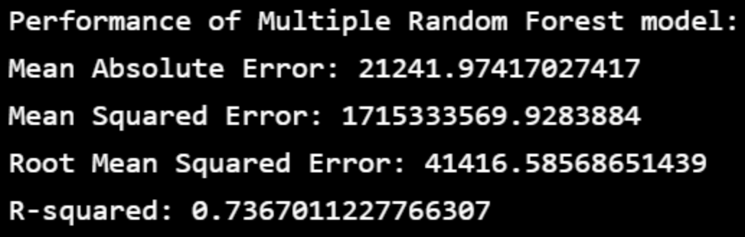
Analysis on the Machine Learning Model Model 1
Random Forest
n_estimators
The number of decision trees the model will be running.
random_state
Sets a seed to the random generator.
Outputs
MEA: 21,241.974
MSE (Mean Squared Error): 1,715,333,569.928
RMSE (Root Mean Squared Error): 41,416.586
R-Squared: 0.737

Slide 12
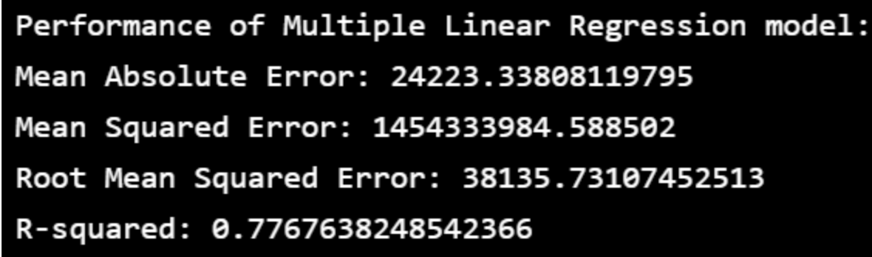
Analysis on the Machine Learning Model Model 2
Multiple Linear Regression(MLR)
It is used for determining the relationship between variables and forecasting.
Outputs
MEA: 24,223.338
MSE: 1,454,333,984.589
RMSE: 38,135.731
R-Squared: 0.777 The results from the Linear
Regression model are similar, but not the same, as the Random Forest model.

Slide 13
Analysis on the Machine Learning Model Model 2
Multiple Linear Regression(MLR)
It is used for determining the relationship between variables and forecasting.
Outputs
MEA: 24,223.338
MSE: 1,454,333,984.589
RMSE: 38,135.731
R-Squared: 0.777 The results from the Linear
Regression model are similar, but not the same, as the Random Forest model.

Slide 14
Analysis on the Machine Learning Model Model 2
Multiple Linear Regression(MLR)
It is used for determining the relationship between variables and forecasting.
Outputs
MEA: 24,223.338
MSE: 1,454,333,984.589
RMSE: 38,135.731
R-Squared: 0.777 The results from the Linear
Regression model are similar, but not the same, as the Random Forest model.

Slide 15
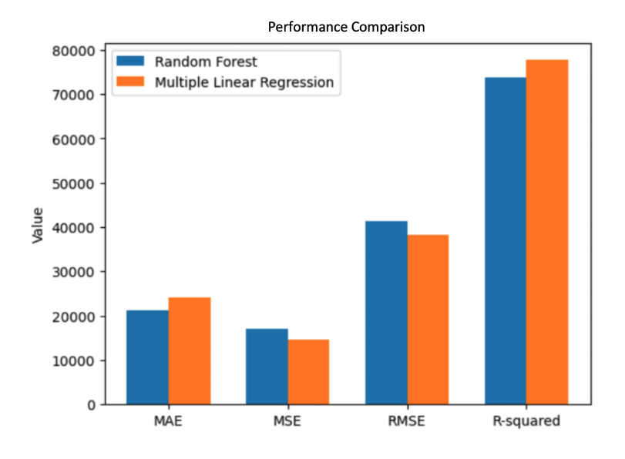
Performance Comparison of 2 Models

Slide 16
Performance Observation of 2 Models
Both the MSE and RMSE were lower in the Linear Regression model than the Random Forest model. Making the Linear Regression model more suitable for predicting the house sale values.
The MAE was lower in the Random Forest model than the Linear Regression hence making the Random Forest model more suitable for predicting the house sale values.
The R-Squared was higher in the Linear Regression model than the Random Forest model. Therefore, the Linear Regression model is more suitable for predicting the house sale values.
In conclusion, out of the four different scores, three sided with the Linear Regression model being the most apt model to use for further work.

Slide 17
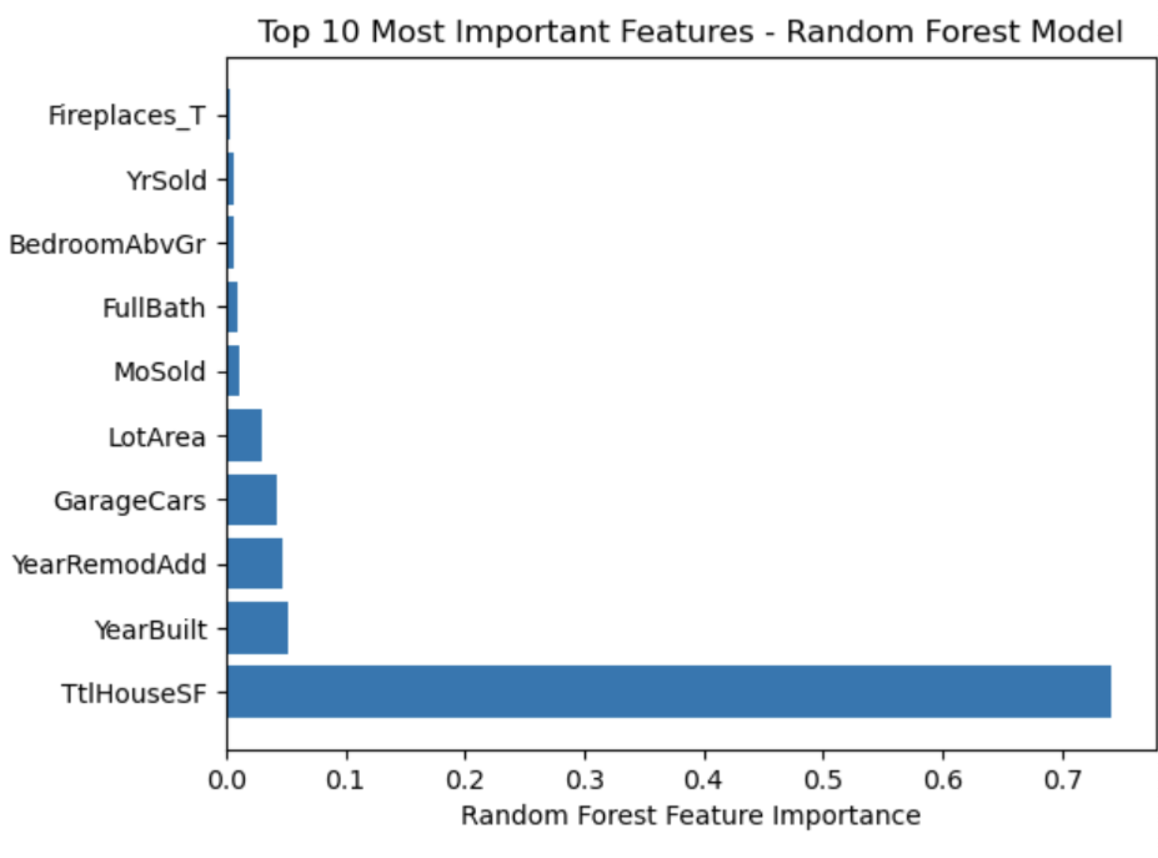
Top 10 Most Important Features
The ‘enumerate’ function was used to determine the importance “value” of all the categories, where the results were placed into a dataframe and ordered by level of importance.

Slide 18
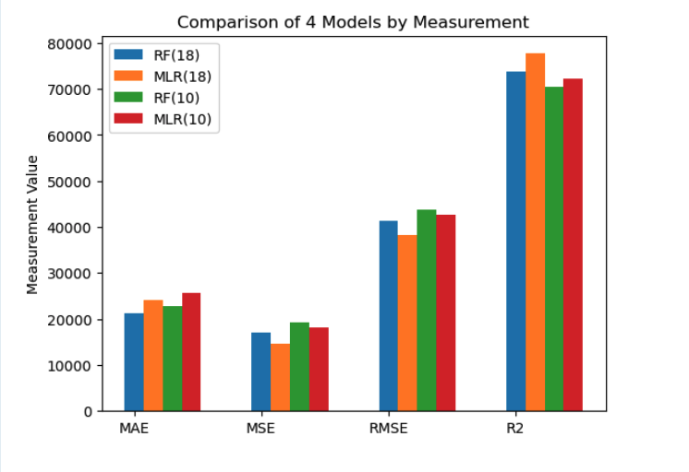
Refining The Model
The 2 other Random Forest and Multiple Linear Regression models were built and trained using only the top 10 most important features instead of 18 features used in the model 1 and model 2.

Slide 19
Performance Comparison of 4 Models
The lower MAE means a better fit for the model, so between the models running the 18 variables, the linear regression model is the one with the best fit. Furthermore, between the models working with the top ten features, the random forest model has a better fit.
The relationship with the MSE is the same as the MAE. The lower the score the better. In the case of the 18 variable models, the linear regression has a better fit. For the models running the top ten variables the random forest model has a better fit.
Based on the results for the RMSE, the model which has a better fit, for 18 variables, is the linear regression model, and the model most appropriate for running the top ten features is the random forest.
Based on the results of the R-Squared test, where a higher score determines the better fit, it can be noted that the random forest model works best for the 18 variables. However, for the models running the top ten features the linear regression model is more appropriate.

Slide 20
Conclusion of Comparison
For running the model with the original 18 variables submitted, it is recommended to use the linear regression model, as it outperformed the random forest model in three out of four tests, with an accuracy score of 77%.
On the other hand, for the model running the top ten variables, it is recommended to use the linear regression model, as it outperformed the random forest model in three out of four tests.

Slide 21
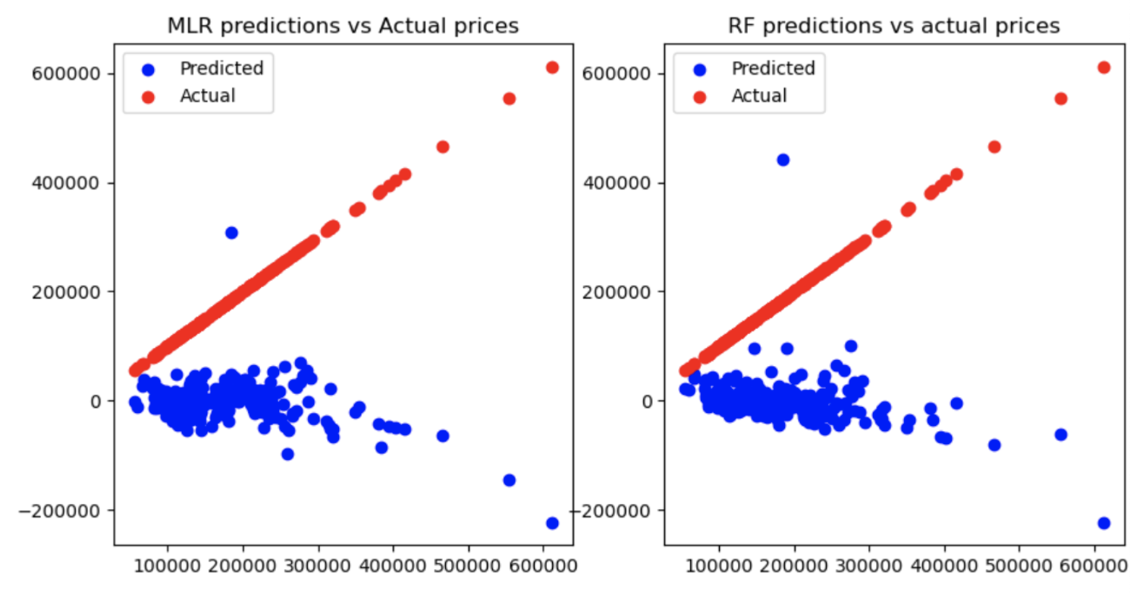
Visualization of Predicted Values Vs. Actual Values

Slide 22
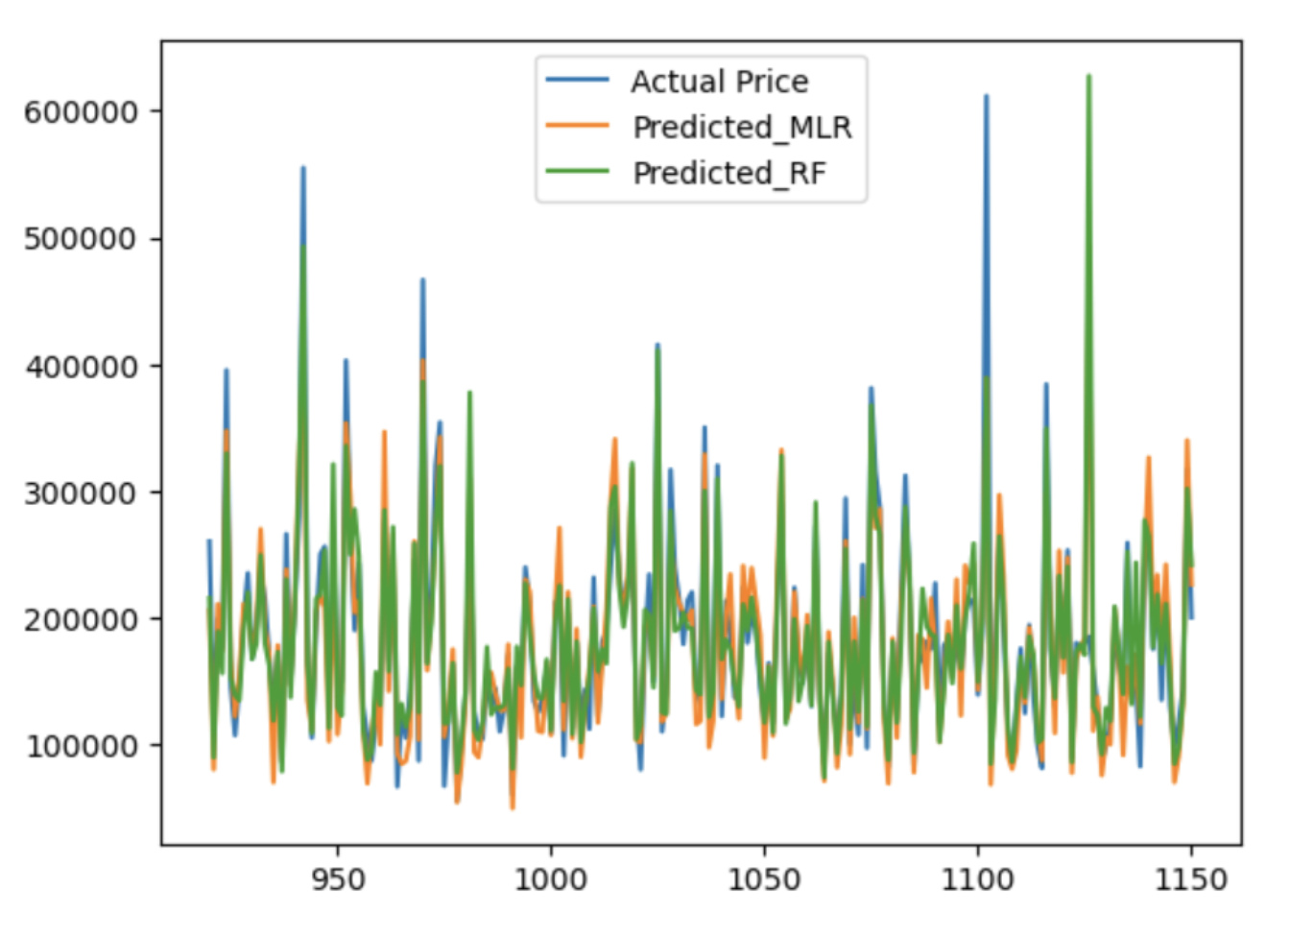
Visualization of Predicted Values Vs. Actual Values

Slide 23
Recommendations for a Future Analysis

Slide 24

What Could Be Next?
An HTML page, where the users apply the variable features interactively to predict their house sale prices, could be created for a future project.

Slide 25


